Slide 1
FUNDAMENTALS OF MANAGEMENT
MODULE - 1

Slide 2

Meaning
Management is a purposive activity. It is something that directs group efforts towards the attainment of certain pre–determined goals.
The process of getting things done, effectively and efficiently, through and with other people.
Efficiency
Means doing the thing correctly; refers to the relationship between inputs and outputs; seeks to minimize resource costs
Effectiveness
Means doing the right things; goal attainment

Slide 3
Definitions
“Management is an art of getting things done through and with the people in formally organized groups and can co-operate towards attainment of group goals”.
- Harold Koontz

Slide 4
Definitions
To manage is to forecast and to plan, to organize, command, coordinate and control.
-Philip Kotler

Slide 5
Definitions
Management is the force that integrates men and physical plant into an effective operating unit.
- Keith and Gubelline

Slide 6
Definitions
"Management is the guidance, leadership and control of the efforts of group of persons for a common object."
-William H. Newman
"Management is the planning process of the working of an industry."
- Breach

Slide 7

Nature/Characteristics
Management is both Science and Art
Management as Profession
Management is a Mobile process
Management is inherent and earned genius
Management is important in every field
Socially Responsible
Management in the form of entire development
Management is a process
Management is a collective effort
Management is the achievement of pre-determined goals
Necessary at All Levels
Universal Process

Slide 8
Nature/Characteristics
Management is both Science and Art:
Management is both Science and Art because the subject is studied in serial order and problems are considered for solution. As a science, it narrates several important laws.
Under the art of management are included systems, policies and techniques so as to achieve the pre-determined goals.
Theoretical knowledge must be supplemented and perfected by practical knowledge. Both theory and practice are equally important for management.

Slide 9
Nature/Characteristics
Management as a Profession:
Business management has been adopted by persons as a profession in developed countries like America, Germany, Britain and France.
At present special knowledge is essential for efficient management in India like other countries. Several institutions have started to impart training in management.

Slide 10
Nature/Characteristics
Management Is a Mobile Process:
Management is not only ordering, organizing, directing, coordinating and controlling, but it is a mobile process.
It involves continuous thinking, analysis and decision making.
The manager himself determines the path according to the circumstances and marches onwards.

Slide 11
Nature/Characteristics
Management is an Inherent and Earned Genius:
Managers are born and not made. They can lead successfully and organize others well.
But with the passage of time, this thinking has become obsolete.
Today management work has become very complicated.
It has become necessary to study business management regularly and take training for the successful working.

Slide 12
Nature/Characteristics
Management is important in every field:
The importance of management is not only in the field of business but also in social, political and economic fields.
Therefore, management is a universal process.

Slide 13
Nature/Characteristics
Socially Responsible:
The important aspect of management is that the manager is not only liable towards his employer but towards the whole society.
It is the social responsibility of a manager to work in such a manner that it may help in the development of a nation.

Slide 14
Nature/Characteristics
Management in the Form of Entire Development:
In modern age, management work is not only limited up to direction, organization, guidance and control, but other factors are also included in it.
Management must not only limit its activities in its enterprise but also in view of the national and international field, management activities should be adjusted with different cultures.
Elements of management must be examined and accepted keeping in view social and human values.

Slide 15
Nature/Characteristics
Management is a Process:
Management is a process which starts with pre-determined goal and ends in achievement of that goal.
A plan is formulated to gain the objective, Organization is arranged to work according to the plan.
Necessary orders and directions are given to implement the plans.
All the activities are coordinated. This process of management goes on continuously.

Slide 16
Nature/Characteristics
Management is a Collective Effort:
Management always gives importance to collective efforts.
Therefore, Koontz said, "Organized in formal groups," Raynold said, "Agency of Community," and Massey said, "Co-operative Group".
The objectives of an organization can be easily obtained by a group rather than by a man.

Slide 17
Nature/Characteristics
Management is achievement of pre-determined objects:
Efforts of a group are directed in management in order to obtain the predetermined objects.
In the words of Haimann, "Effective management helps in attainment of objectives."

Slide 18
Nature/Characteristics
Management is necessary at all levels:
Management applies at all levels of organization.
A low grade supervisor has to take decision and manage affairs like a senior officer.

Slide 19
Nature/Characteristics
Management is a universal process:
Application of principles and techniques of management are not restricted only to business but they have universal application.
They are applied to social, religious, charitable and non-profit organizations also.
In absence of management, none of the organizations can walk a single step. Without management, organizational goals and objectives would not be achieved.
Management is the life blood of the organization.

Slide 20
Importance of Management
Maximum Production at Minimum Cost
Maximum Utility of Factors of Production
Enhances competitiveness
Solution of Business Complexities
Improves co-ordination among factors of Production
Develops co-ordination between traditional and modern systems

Slide 21
Encouragement of Research Work & Investigation
For the Attainment of Social Objectives
Management meets the challenges of changes
Management integrates various interests
Management provides stability

Slide 22
MANAGEMENT FUNCTIONS

Slide 23
Management Functions
There are basically five management concepts that allow any organization’s manager to handle the tactical, planned and set decisions.
The five basic functions of the manager are just to have a controlled plan over the preventive measure.

Slide 24
Planning
Planning is the first tool in the managerial task.
The difference between a successful and an unsuccessful manager lies within the planning procedure.
Planning is the logical thinking through goals and making the decision as to what needs to be accomplished in order to reach the organizations’ objectives.
Managers use this process to plan for the future, like a blueprint to foresee problems, decide on the actions to evade difficult issues and to beat the competition.

Slide 25
Organizing
The second function of the manager (management) is getting prepared, getting organized.
Manager must organize all its resources well before hand to put into practice the course of action to decide that has been planned in the base function.
Through this process, manager determines the inside directorial configuration; establish and maintain relationships, and also assign required resources.

Slide 26
Staffing
The third function of manager is staffing.
After the organizational functions are done, he organizes his staffing by recruiting, selecting, training, and developing employees.
A manager in a large organization often works with the company’s human resources department to accomplish this goal.

Slide 27
Directing
It involves the implementation of plans by mobilizing individuals and group efforts through motivation, communication, leadership and supervision.
Directing may be defined as the process of activating the efforts of employees towards the achievement of organizational objectives.

Slide 28
Controlling
It is the process of regulating the ongoing activities of the organization to ensure that they are in conformity with the established plans and produce the desired results.
Through the controlling function, management can keep the organization towards its chosen track.

Slide 29
Process of Carrying out the Functions
Establishing standards of performance
Measuring current performance
Comparing actual results with the established standards
Detecting deviations from the standards
Taking corrective actions for significant deviations.

Slide 30
Roles of Manager- The Managerial Role
The roles in this category involve providing information and ideas.
Figurehead - A manager has social, ceremonial and legal responsibilities. He is expected to be a source of inspiration. People look up to him as a person with authority, and as a figurehead.
Leader - This is where manager provide leadership for his team, his department or perhaps his entire organization; and its where he (manager) manage the performance and responsibilities of everyone in the group.
Liaison - Managers must communicate with internal and external contacts. He needs to be able to network effectively on behalf of his organization.

Slide 31
Roles of Manager- Decisional Role
The roles in this category involve using information.
Entrepreneur - A manager creates and control change within the organization. This means solving problems, generating new ideas, and implementing them.
Disturbance Handler - When an organization or team hits an unexpected roadblock, its the manager who must take charge. He also needs to help mediate disputes within it.

Slide 32
Key Skills
Analytical Skills
Technical Skills
Communication Skills
Selling Skills Planning
Skills Reviewing Skills
Managerial Skills
Negotiating Skills
Administrative Skills
Interviewing Skills
Counseling Skills
Forecasting Skills
Leadership Skills

Slide 34

Management vs Administration

Slide 35
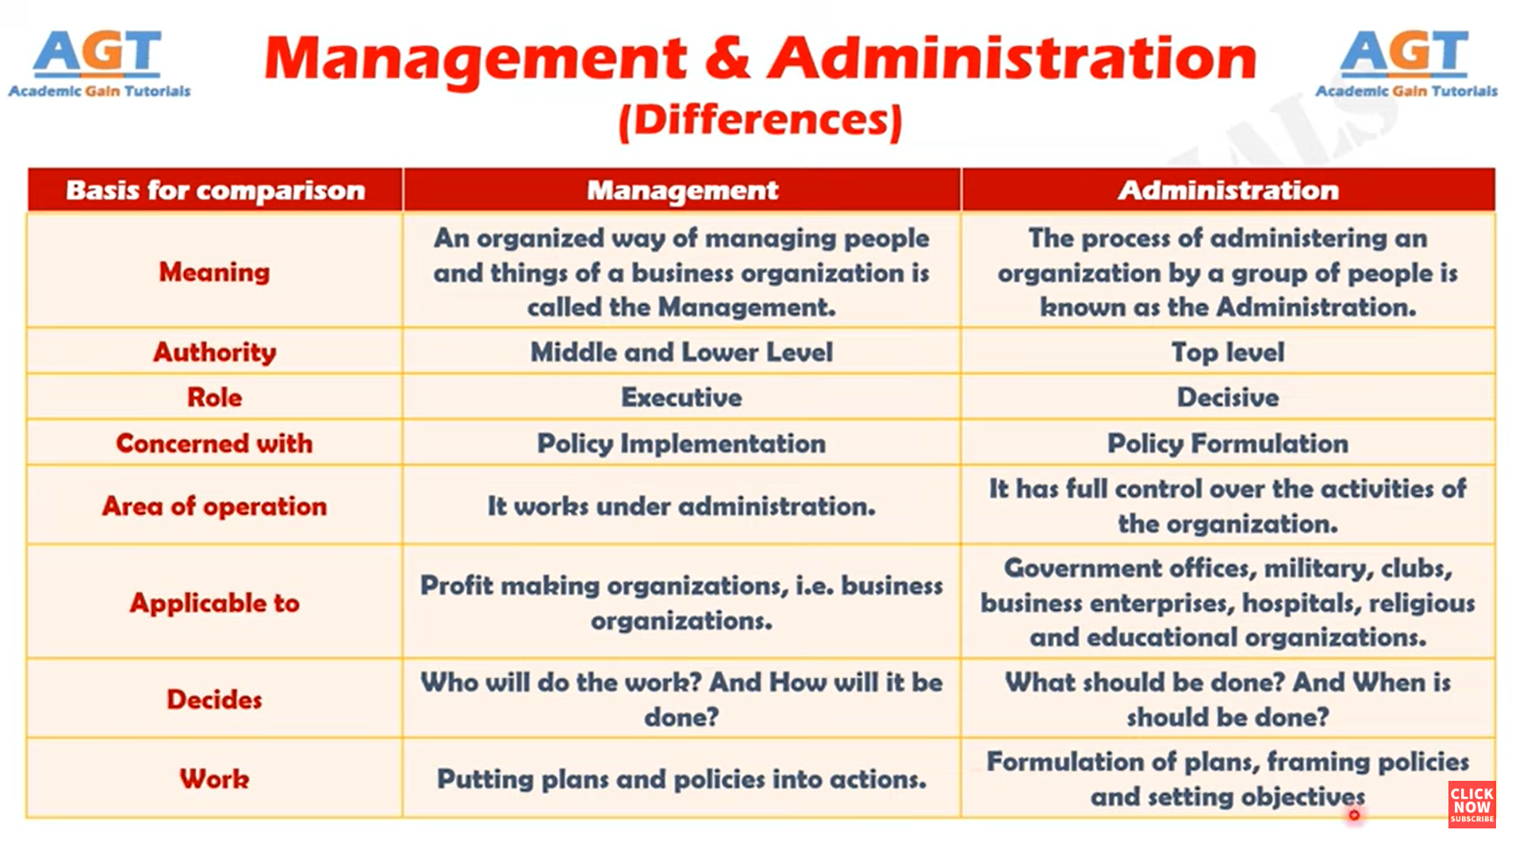

Slide 36
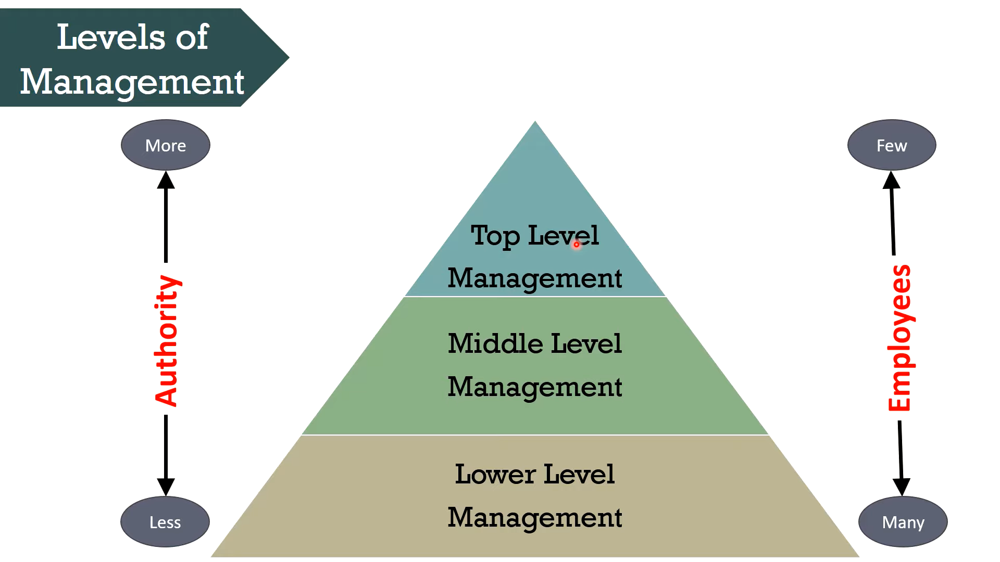
Levels of Management

Slide 37
DECISION MAKING

Slide 38
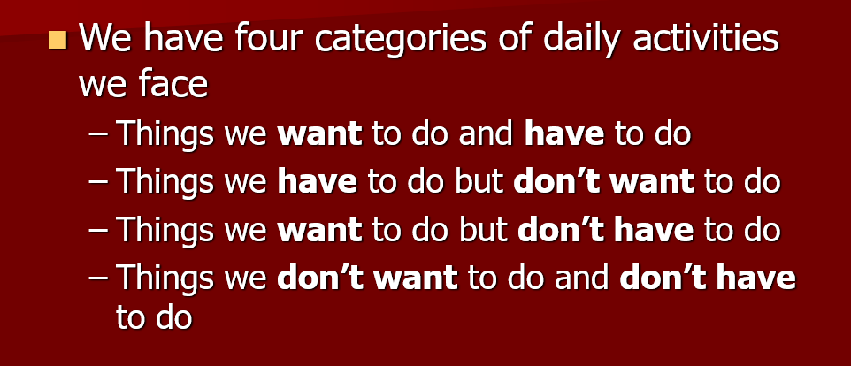

Slide 39
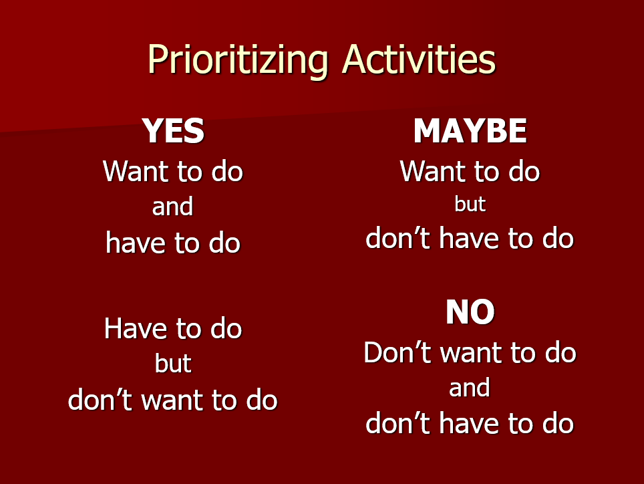

Slide 40
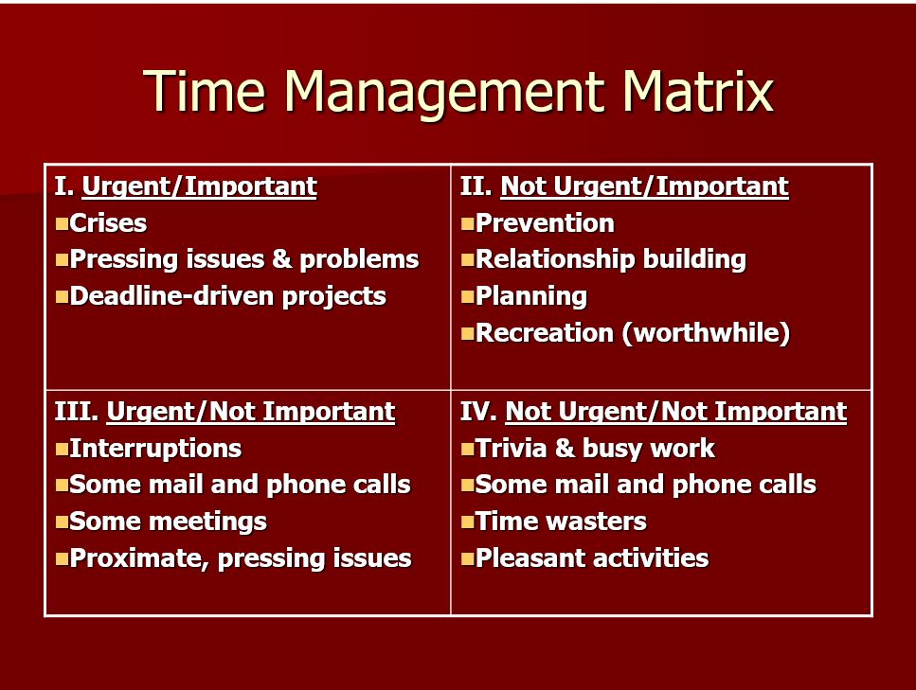

Slide 41
Decision Making
The process by which mangers respond to opportunities and threats by analyzing options and making decisions about goals and course of action.
Decisions in response to opportunities : Managers respond to ways to improve organizational performance.
Decisions in response to threats: When Managers are impacted by adverse events to organization.

Slide 42
Types of Decision Making
Programmed and Non-Programmed Decisions
Operational and Strategic Decisions
Organizational and Personal Decisions
Major and Minor Decisions
Individual and Group Decisions
Tactical and Operational Decisions

Slide 43
Types of Decision Making
Programmed and Non-Programmed Decisions
Programmed decisions are routine and repetitive in nature. These decisions deal with common and frequently occurring problems in an organization such as buying behavior of consumers, sanctioning of different types of leave to employees, purchasing decisions, salary increment, etc.
Non-programmed decisions are not routine or common in nature. These are related to exceptional situations in which guidelines or routine management is not set. For example, problems arising from a decline in market share, increasing competition in the business environment. The majority of the decisions taken by managers do fall in this non programmed category.

Slide 44
Types of Decision Making
Operational and Strategic Decisions
Operational decisions are just the normal functioning of the organization. These decisions do not require much time and take a shorter time as compared to other decisions taken. Ample of responsibilities are delegated to subordinates. The main decision is to create harmony in an organization and to see whether the management is proper or not.
Strategic decisions include all present issues and problems. The main idea is to achieve better working conditions, better equipment, and efficient use of existing equipment, etc. These all fall under this category. Usually, strategic decisions are taken by top-level management.

Slide 45
Types of Decision Making
Organizational and Personal Decision
If the decision is taken collectively keeping in mind the organizational goal, it is known as the organization goal, and if the manager takes any decision in the personal capacity (affecting his/her life). It is known as personal decisions. These decisions may sometimes affect the functioning of the organization as well. For example, if the employee has decided to leave the organization, it may affect the organization. The authority of taking personal decisions cannot be delegated and is dependent on the individual itself.

Slide 46
Types of Decision Making
Major and Minor Decisions
These are classified as the type of decision-making in management where decision-related to purchase of new premises is a major decision. These are taken by top management whereas the purchase of stationery is a minor decision. Minor decisions can be taken by the superintendent.
Individual and Group Decision
When the decision is taken by an individual, it is categorized as an individual decision. Usually, routine decisions are taken by individuals within the policy framework of the organization.
Group decisions are taken by a group of individuals in the form of a standing committee. Generally, important types of decisions in management are shifted to this committee. The main aim of a group decision is to involve the maximum number of individuals in the process of decision making.

Slide 47
Types of Decision Making
Tactical and Operational Decision
Decisions that are pertaining to various policy matters in the organization are known as policy decisions. These are taken by top management and do have a long-term impact on the organization. For example, decisions regarding the location of the plant or volume of production. These are tactical decisions
Operational decisions are all day-to-day decisions that need to be taken for the proper functioning and operation of the organization. These can be taken by middle or lower-level managers. For example, the Calculation of bonuses given to each individual is an operational decision and is performed by middle or lower-level managers.

Slide 48
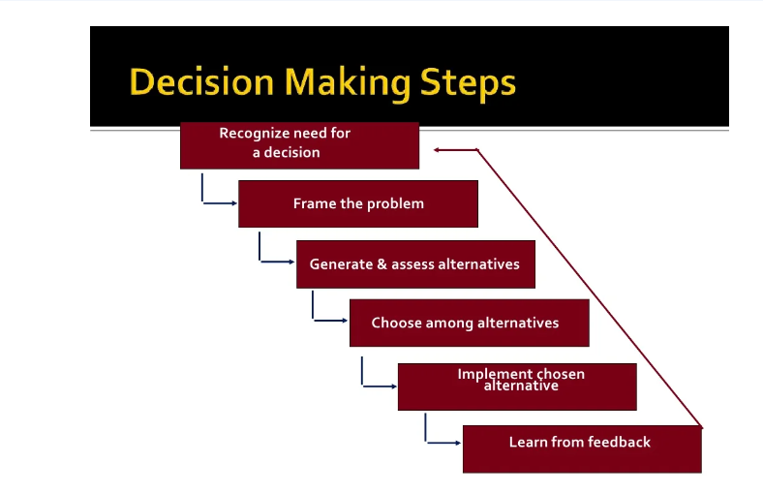
Levels of Management
Raghav Mehrontra

Slide 49
Cross Cultural Management Case Study: Effective Business Management By Alizee Airline
Question
Task: The purpose of this assignment is to assess students’ ability to identify the cultural values and dimensions of different cultures and their impact on international business performance. The students should apply this knowledge from the perspective of a consultant, advising the Alizee airlines company how they could mitigate some of the cross-cultural problems to enhance business performance.
Using GLOBE Study’s cultural dimensions as a point of reference, identify and discuss the cultural similarities and differences between India, china and USA illustrated in the case.

Slide 50
Cross-Cultural Issues In Management/Workplace Environments
There are many benefits of cultural diversity in the workplace, including increased ability to solve problems, higher productivity, and innovative ideas. But an organization can only enjoy these benefits when culture-related conflicts are identified, eradicated, and prevented.

Slide 51
Religion
Religion is a core cultural characteristic of many people's identity and it can affect perceptions, intentions as well as work behavior. Different beliefs and ethical principles can cause conflict among co-workers or even lead to religious discrimination.
Your organization needs to have policies and religious accommodations to ensure everyone is respectful of each others' beliefs while still providing a fair standard of conduct for customers and clients.

Slide 52
Gender Identity
Workplace issues due to Gender orientation are very common. Some gender communities are often subject to harassment, hostility, biased jokes, or inappropriate questionsº that lead to employee disengagement. In fact, many workers hide their identities for fear of discrimination.

Slide 53
Education
The educational level is also part of people's background and affects how they fit into workplace environments. Differences in educational experiences mean different approaches to problems and situations in the workplace. This can cause conflicts among employees working on the same projects but implementing certain methodologies based on their own education.

Slide 54
Ethnicity
The term "ethnicity" refers to belonging to a social group who identify with each other based on their shared attributes like common heritage, language, identity, and origin. Common examples of ethnicity include: Hispanic, Irish, Cambodian, or Jewish. Each has its unique behavior patterns, mannerisms, and communication styles.

Slide 55
Generation
Depending on their generation, employees may also have different outlooks, values, and ideas about business and professionalism. For example, older generations tend to have long-term career expectations, making them more loyal to an employer.
On the other hand, Millennials tend to have a higher value of work-life balance and consistently seek growth opportunities, so they are most likely to move on to another company or higher positions.

Slide 56
Cultural Behavior
Sophie , who recently migrated from Singapore, is starting a new job as a newspaper editor in New York. After a couple of weeks, she notices her co-workers are not approaching her much and she feels like she doesn't fit in. She decides to bring it up with her manager to see if he has any feedback for her.
Her colleagues think she is not friendly or doesn't like them because she avoids eye contact when speaking with them. That makes it uncomfortable for everyone else to have a conversation with Chloe. So she does this because direct eye contact can be considered aggressive or rude in Singaporean culture

Slide 57
Experience Clashes
Omar, who recently graduated in marketing, just started a new job at a local agency. He starts working on a new project, along with two other employees who have been part of the agency for a couple of years.
He quickly finds that his observations and ideas are not being taken into consideration, and when he brings it up with his colleagues, he's told "that's just not how we do it here". He knows that marketing strategies change constantly and he could bring new and fresh ideas to the table, but he keeps on being shut down.
Omar will soon lose motivation and could start looking for other job opportunities where he feels like he can contribute more.

Slide 58
Thank you

